Slide 1
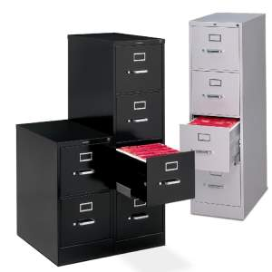
Operating system
Part XI: IO System (Other)

Slide 2
Goals
Know the advanced services provided by most Oss
Scheduling algorithms for disk I/O requests
SPOOLING [虚拟脱机技术]
RAID
Redundant backup for the safe storage
USB
Universal interface for diverse devices
NAS, SAN, ...
Scattered storage

Slide 3
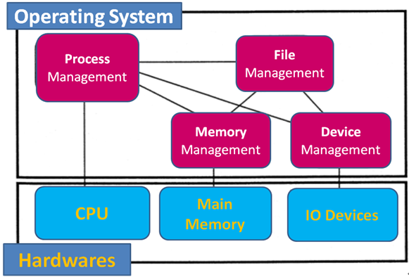
Review
We also have mentioned the four components of OS

Slide 4
Advanced IO
Scheduling algorithms for disk I/O requests
SPOOLing
RAID
Redundant backup for the safe storage
USB
Universal interface for diverse devices
NAS, SAN, ...
Scattered storage

Slide 5
OS is responsible for using hardware efficiently
For disk drives →fast access time and disk bandwidth
Access time has two major components
Seek time is the time for the disk to move the heads to the cylinder containing the desired sector
Seek time ≈ seek distance
Minimize seek time
Rotational latency [旋转延迟] the additional time waiting for the disk to rotate the desired sector to the disk head
Difficult for OS
Disk bandwidth is the total number of bytes transferred, divided by the total time between the first request for service and the completion of the last transfer

Slide 6
Disk Optimizations
Disk latency time: Rotational delay waiting for proper sector to rotate under R/W head
Disk seek time: Delay while R/W head moves to the destination track/cylinder
Transfer Time: Time to copy bits from disk surface to memory
Access Time = seek + latency + transfer
PPTs from others\cms.dt.uh.edu\chap05.ppt

Slide 7
Seek time
Rotational delay
Transfer time

Slide 8
Several algorithms exist to schedule the disk I/O requests
We illustrate them with a request queue (0-199).
98, 183, 37, 122, 14, 124, 65, 67
After visiting 40, current Head pointer is at 53

Slide 9
FCFS [先来先服务算法]
First come, first serve (FCFS): requests are served in the order of arrival
+ Fair among requesters
- Poor for accesses to random disk blocks
98, 183, 37, 122, 14, 124, 65, 67
199
183
Total seek distance:
(98-53)+(183-98) + (183-37) + (122-37)
+ (122-14) + (124-14) + (124-65)
+ (67-65)
= [(183+122+124) – (37+14+65)]*2
+ (67-53)
= [429 - 116]*2 + 14
= 640
180
160
140
122
124
120
Tracks
100
98
080
67
060
65
040
53
020
37
000
14
Time
Notes:
[2012-11-05] 上周五讲了这一部分, 觉得其中的例子应该统一!
FCFS 的寻道距离计算技巧: (止–起) + [上层节点之和 – 下层节点之和]*2
NB: 凡是不上不下的 (如 此处的98) 可以忽略不计.

Slide 10
SSTF [最短寻道时间优先]
Shortest seek time first (SSTF): picks the request that is closest to the current disk arm position
+ Good at reducing seeks
- May result in starvation
98, 183, 37, 122, 14, 124, 65, 67
SORTING first: 14, 37 - [53] - 65, 67, 98, 122, 124, 183
199
183
180
160
Total seek distance:
(Similar with the FCFS)
[67 -14]*2 + (183-53)
= 53*2 + 130
= 106 + 130
= 236
Also = (183-14)+(67-14)+(67-53)
= 236
140
120
122
124
Tracks
100
98
080
65
67
060
040
53
020
37
000
14
Time
Notes:
[2012-11-05] SSTF: 简便处理
先是排序 – 14, 37, 65, 67, 98, 122, 124, 183
起始位置也加入其中 - 14, 37, [53], 65, 67, 98, 122, 124, 183
那么, SSTF 的规律就是每次选离当前位置最近的. 53 →65[12] →67[2] →37[30] → 14[23] →98[84] →122[24] →124[2] →183[59]

Slide 11
SCAN
The disk arm starts at one end of the disk, and moves toward the other end, serving requests until it gets to the other end of the disk, where the head movement is reversed and servicing continues.
Sometimes called the elevator algorithm [电梯算法].

Slide 12
Elevator Algorithms
PPTs.2012\PPTs from others\u.cs.biu.ac.il_~ariel_download_os381_ppts\os10-3_dsk.ppt
Algorithms based on the common elevator principle.
Four combinations of Elevator algorithms:
– Service in both directions or in only one direction.
– Go until last cylinder or until last I/O request.
Go until
Go until the
last request
Direction
Go until the
last cylinder
Service both
directions
Scan
Look
Service in only
one direction
C-Scan
C-Look

Slide 13
SCAN
SCAN: takes the closest request in the direction of travel (an example of elevator algorithm)
- a new request can wait for almost two full scans of the disk
98, 183, 37, 122, 14, 124, 65, 67
SORTING first: 14, 37 - [53] - 65, 67, 98, 122, 124, 183
199
183
199
180
160
Total seek distance:
(Quite straight)
[199]*2 – (53 + 14)
= 398 - 67
= 331
Also = (199-14)+(199-53)
= 331
140
120
122
124
Tracks
100
98
080
65
67
060
040
53
020
37
000
14
Time

Slide 14
Get the end of each side [摸边]
PPTs from others\www.cs.mtu.edu_~shene_OS-slides\chap13-IO-Sys.pdf
This algorithm requires one more piece of information:
the disk head movement direction, inward or outward.
The disk head starts at one end, and move toward the other in the current direction.
At the other end, the direction is reversed and service continues.
Some authors refer the SCAN algorithm as the elevator algorithm.
However, to some others the elevator algorithm means the LOOK algorithm.

Slide 15
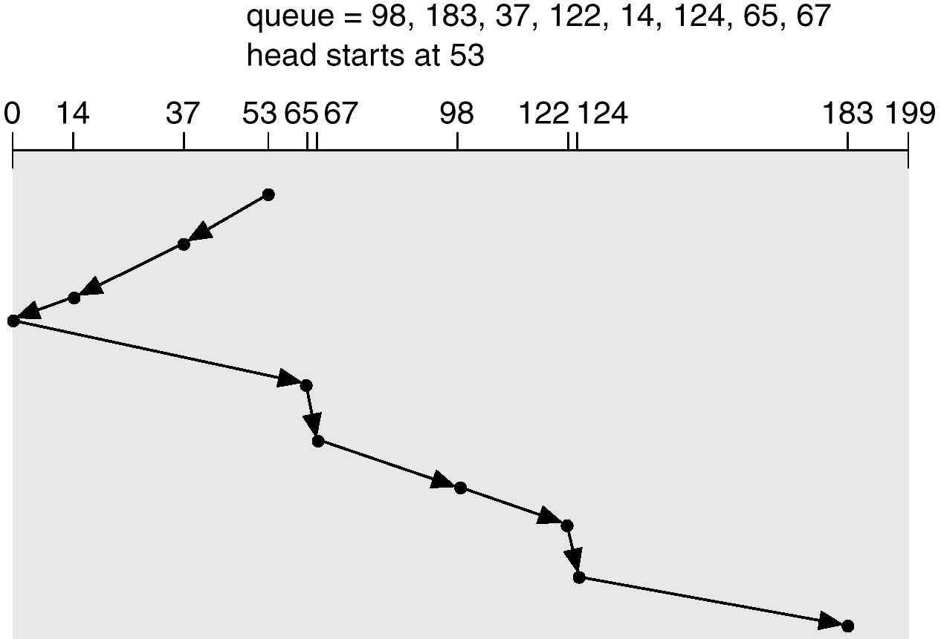
SCAN

Slide 16
C-SCAN
Circular SCAN (C-SCAN): disk arm always serves requests by scanning in one direction.
Once the arm finishes scanning for one direction
Returns to the 0th track for the next round of scanning
98, 183, 37, 122, 14, 124, 65, 67
SORTING first: 14, 37 - [53] - 65, 67, 98, 122, 124, 183
199
183
199
180
160
Total seek distance:
(Quite straight)
[199-0]*2 + (37-53)
= 398 - 16
= 382
Also = (199-53)+(199-0)+(37-0)
= 382
140
120
122
124
Tracks
100
98
080
65
67
060
040
53
020
14
37
000
Time
0

Slide 17
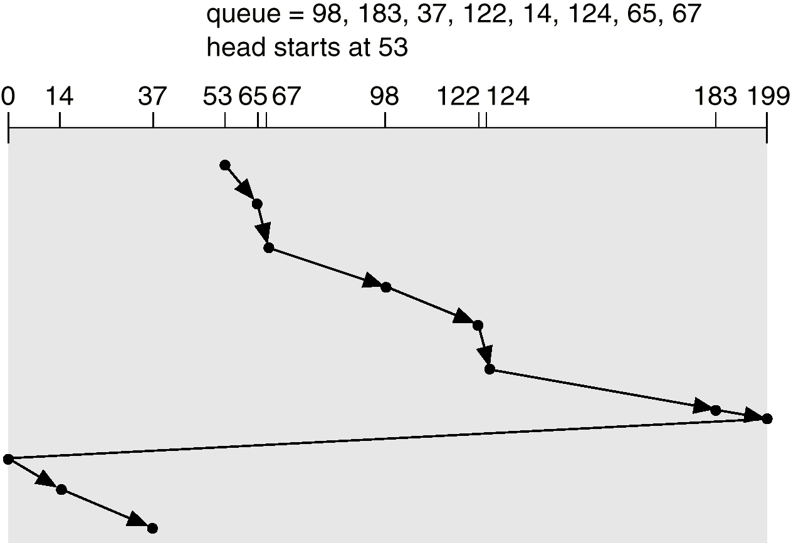
C-SCAN

Slide 18
LOOK scheduling
With SCAN and C-SCAN, the disk head moves across the full width of the disk.
This is very time consuming. In practice, SCAN and C-SCAN are not implemented this way.
LOOK:
It is a variation of SCAN. The disk head goes as far as the last request and reverses its direction.
C-LOOK:
It is similar to C-SCAN. The disk head also goes as far as the last request and reverses its direction.
PPTs from others\www.cs.mtu.edu_~shene_OS-slides\chap13-IO-Sys.pdf
Notes:
Zh 5-7

Slide 19
LOOK
98, 183, 37, 122, 14, 124, 65, 67
SORTING first: 14, 37 - [53] - 65, 67, 98, 122, 124, 183
199
183
180
160
Total seek distance:
(Quite straight)
[183]*2 – (53 + 14)
= 366 - 67
= 299
Also = (183-53)+(183-14)
= 299
140
120
122
124
Tracks
100
98
080
65
67
060
040
53
020
37
000
14
Time

Slide 20
C-LOOK
Variation of C-SCAN
Arm only goes as far as the last request in each direction, then reverses direction immediately, without first going all the way to the end of the disk.
98, 183, 37, 122, 14, 124, 65, 67
SORTING first: 14, 37 - [53] - 65, 67, 98, 122, 124, 183
199
183
180
160
Total seek distance:
(Quite straight)
[183 - 14]*2 + (37-53)
= 169*2 - 16
= 322
Also = (183-53)+(183-14)+(37-14)
= 322
140
120
122
124
Tracks
100
98
080
65
67
060
040
53
020
37
000
14
Time

Slide 21
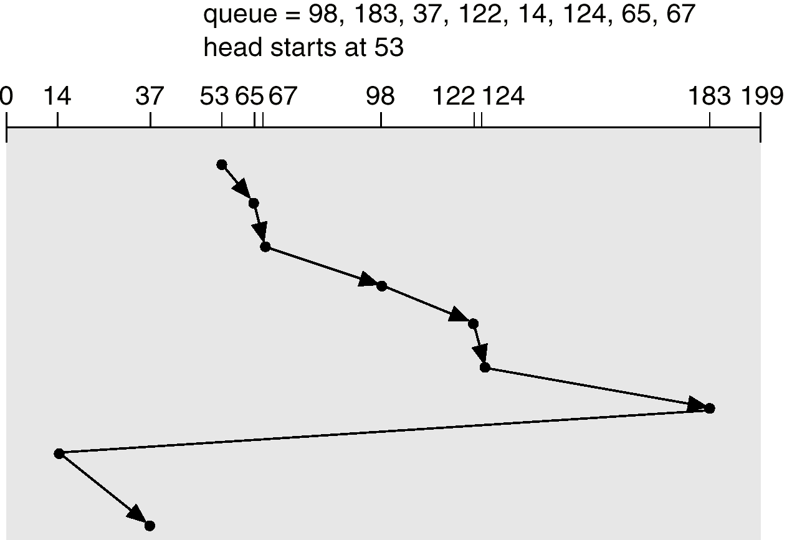
C-LOOK

Slide 22
Selecting a Disk-Scheduling Algorithm
SSTF is common and has a natural appeal
SCAN and C-SCAN perform better for systems that place a heavy load on the disk
Performance relies on the number and types of requests
Requests for disk service can be influenced by the file-allocation method (Contiguous? Linked? Indexed?)

Slide 23
Selecting a Disk-Scheduling Algorithm
The disk-scheduling algorithm should be written as a separate module of the operating system, allowing it to be replaced with a different algorithm if necessary
Either SSTF or LOOK is a reasonable choice for the default algorithm
Scheduled by OS or by disk controller?

Slide 24
Advanced IO
Scheduling algorithms for disk I/O requests
SPOOLING
RAID
Redundant backup for the safe storage
USB
Universal interface for diverse devices
NAS, SAN, ...
Scattered storage
Simultaneous Peripheral Operations On-line:
同时的外围设备联机操作(假脱机技术)

Slide 25
Basic Printer Operation
A Printer is a peripheral device, usually attached to a host computer
The host computer transfer print files to the printer over the communication channel

Slide 26
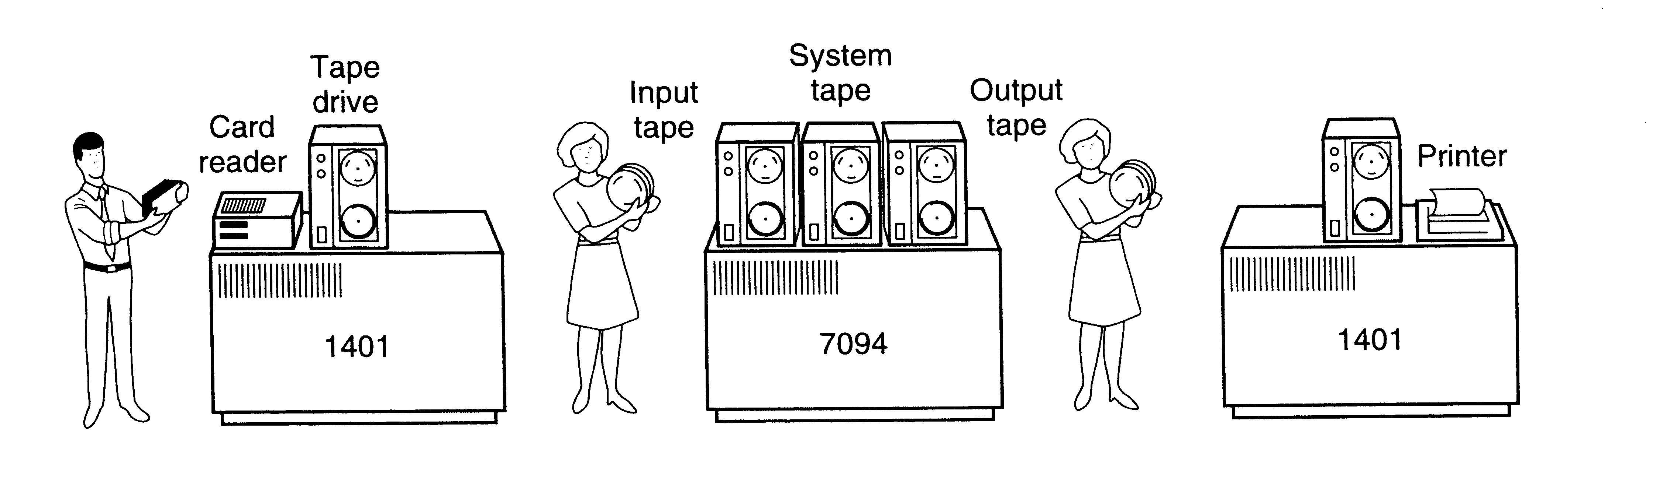
Traditionally
There is an input machine to read cards into tapes
Then a person carries that full tape to the processor
After the processor output the result into an output tape, another person carries the output tape to an output machine
The output machine prints the result out

Slide 27
Motivation
Background – Multiprogramming
The value of multiprogramming is that more programs can be run in the same amount of time.
If the turnover rate [周转率] of those programs can be increased, even greater efficiencies can be realized.
For example
Imagine a given system executes five concurrent programs, and that each program occupies memory for 10 seconds.
As soon as a program finishes executing, another one replaces it in memory. Thus, the computer can run thirty programs a minute.
If we could reduce each program’s run time to five seconds, we could run sixty programs in that same minute

Slide 28
On output, data are spooled to disk and later dumped to the printer.
Because the application program deals only with high-speed I/O, it finishes processing much more quickly, thus freeing space for another program
Spooling is a way of dealing with dedicated I/O devices in a multiprogramming system.
A spooling directory is used for storing the spooling jobs

Slide 29
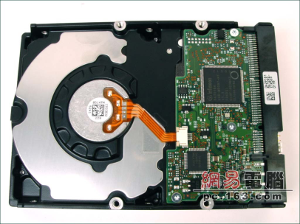
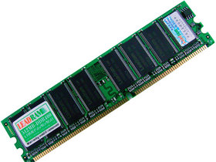
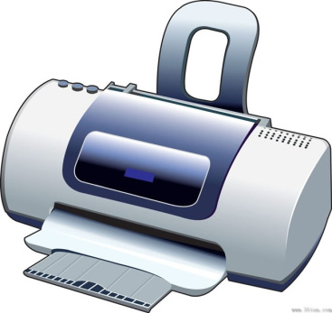
Spooler now
http://en.wikipedia.org/wiki/Spooling
In computer science, spool refers to the process of placing data in a temporary working area for another program to process.
A
B
Spooling
C
Notes:
[2012-11-02 Friday] 讲到这里, 觉得可以将之前的一些概念联系起来:
SPOOLer 其实就是一个简单的服务程序 (可称之为 Daemon 程序): 所有访问某一资源(打印机, 邮件服务器收发 等等)的请求都由之处理 – 将提交的作业保存到临时位置 (输入/输出井, 也就意味着SPOOLer可以从文件系统申请磁盘空间, 以及可以实现内外存的交换), 之后, 由它来调度队列中的作业顺序使用资源 (应该有专门的Controller和Driver来支持与CPU的并发执行 – 就像DMA可以实现IO操作与CPU的并行一样)
有了 SPOOLer 控制专用资源的使用, 也就意味着那个资源在服务程序的包装下体现为新的特性 – 这显然也就是虚拟机的概念: OS 将计算机硬件包装了起来, 体现出了易于用户使用的特性.

Slide 30
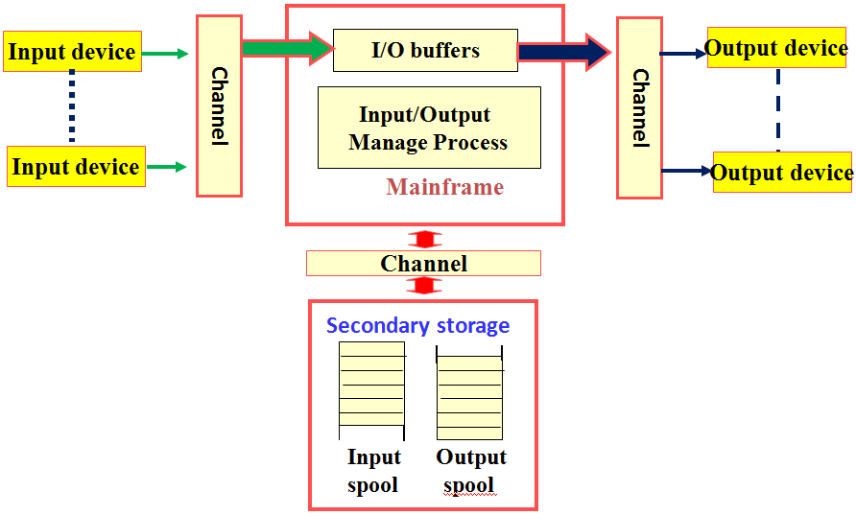
SPOOLing 技术 (Simultaneous Peripheral Operation On Line)
SPOOLING 技术[联机同步外设操作] is a way (buffer-based tech) of dealing with dedicated I/O devices in a multiprogramming system
A spooling daemon process
,I/O buffering
, Channels
, Input/output spooling directories [输入/输出井]

Slide 31
Two Separate Functions
Program-to-Queue.
Queue-to-Printer
Queue-to-Printer
Program-to-Queue
A
B
Spooling
C

Slide 32
SPOOLing 技术 (Simultaneous Peripheral Operation On Line)
When there are processes need input tasks (reading punched cards), they tells the SPLOOLING daemon, then daemon
calls the input management process to put the input data into the input-spooling directory [输入井]
when finished, the daemon notifies the corresponding input process
No matter how many input tasks, all the processes feel like that each of them owns the input device by itself.

Slide 33
SPOOLing 技术 (Simultaneous Peripheral Operation On Line)
When there are processes need output tasks (reading punched cards), they just
put their output data into output-spooling directory [输出井]
then the daemon finishes the output task
No matter how many output tasks, all the output processes feel like that each of them owns the output device (printer) by itself.

Slide 34
SPOOLing can also be used to
Send emails
When user sends a mail, the system places a copy in its private storage (spool area).
The system then initiates transfer to remote machine as a background activity.
The background mail transfer process becomes client.
If it succeeds, the transfer process passes a copy of the message to remote server.
If it fails, the transfer process records the time delivery was attempted and terminates.
The background transfer process sweeps through the spool area periodically (typically every 30 mins).

Slide 35
Cont’
Whenever it finds a message or whenever user deposits new outgoing mail, it attempts delivery.
If mail message cannot be delivered after an extended time, the mail software returns the mail message to sender

Slide 36
Advanced IO
Scheduling algorithms for disk I/O requests
SPOOLING
RAID
Redundant backup for the safe storage
USB
Universal interface for diverse devices
NAS, SAN, ...
Scattered storage
Simultaneous Peripheral Operations On-line:
同时的外围设备联机操作(假脱机技术)

Slide 37
RAID
RAID is originally defined as Redundant Array of Inexpensive Disk(廉价磁盘冗余阵列) ，but the industry redefined I as Independent，not Inexpensive.
On the contrary, we have SLED, that is, Single Large Expensive Disk (单个大而贵的磁盘)。
The basic idea of RAID is
To store the backup (copy or parity bits) of your data among several disks
By using RAID controller, we can use that disk set as one disk
Namely, RAID is just like SLED，but with higher performance and better reliability
RAID controller
We’ve learn the so-called controller ☺
PPTs from others\蒋培.操作系统\CH05.ppt

Slide 38
Motivation of RAID – for better Reliability by redundancy
You all have this experience
After long time consideration of your paper, your computer crashes, and you have not done any backup! ☹
So you MUST have learned that you should make some backup of your important documents every time!
I used to backup my materials in 3 places: computer, a portable hard disk, and network storage space (like “微盘” of BaiDU)
From Ariel J. Frank\OS381\raid.ppt

Slide 39
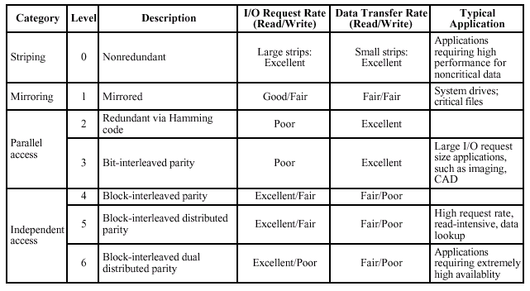
RAID Levels
Mirror the data, or store parity bits
From Ariel J. Frank\OS381\raid.ppt

Slide 40
Hamming Code [哈明码]
Designed to correct single bit errors
Family of (n, k) block error-correcting codes with parameters:
Block length: n = 2^{m} – 1
Number of data bits: k = 2^{m} – m – 1
Number of check bits: n – k = m
Minimum distance: d_{min} = 3
Single-error-correcting (SEC) code
SEC double-error-detecting (SEC-DED) code

Slide 41
(7,4) Hamming code
As an example, we are sending the string “0110”, where m = 4, hence, we need 3 bits for parity check.
The message to be sent is: m₇m₆m₅P₄m₃P₂P₁ where m₇=0, m₆=1, m₅=1, and m₃=0.
Compute the value of the parity bits by:
P₁ = m₇ + m₅ + m₃ = 1
P₂ = m₇ + m₆ + m₃ = 1
P₄ = m₇ + m₆ + m₅ = 0
Hence, the message to be sent is “0110011”.
PPTs from others\www.comp.hkbu.edu.hk_~jng\2006Chapter11.ppt
Notes:
Number of data bits: k = 2^{m} – m – 1
4=2^{m}-m-1 ➔ m=3

Slide 42
Say for example, if during the transmission, an error has occurred at position 6 from the right, the receiving message will now become “0010011”.
To detect and correct the error, compute the followings:
For P₁, compute m₇ + m₅ + m₃ + P₁ = 0
0+1+0+1 = 0
For P₂, compute m₇ + m₆ + m₃ + P₂ = 1
0+0+0+1 = 1
For P₄, compute m₇ + m₆ + m₅ + P₄ = 1
0+0+1+0 = 1
PPTs from others\www.comp.hkbu.edu.hk_~jng\2006Chapter11.ppt

Slide 43
If (P₄P₂P₁ = 0) then there is no error
else P₄P₂P₁ will indicate the position of error.
With P₄P₂P₁ = 110, we know that position 6 is in error.
To correct the error, we change the bit at the 6th position from the right from ‘0’ to ‘1’.
That is the string is changed from “0010011” to “0110011” and get back the original message “0110” from the data bits m₇m₆m₅m₃.
How about is the parity bit broken? – 0111011?

Slide 44
RAID 5 (block-level distributed parity) as instance
block 0
block 1
block 2
block 3
P(0-3)
block 4
block 5
block 6
P(4-7)
block 7
block 8
block 9
P(8-11)
block 10
block 11
block 12
P(12-15)
block 13
block 14
block 15
P(16-19)
block 16
block 17
block 18
block 19
From Ariel J. Frank\OS381\raid.ppt

Slide 45
Advanced IO
Scheduling algorithms for disk I/O requests
SPOOLING
RAID
Redundant backup for the safe storage
USB
Universal interface for diverse devices
NAS, SAN, ...
Scattered storage
Simultaneous Peripheral Operations On-line:
同时的外围设备联机操作(假脱机技术)

Slide 46

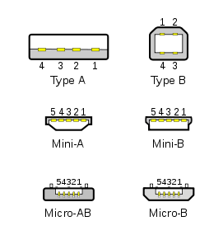
USB: Universal Serial Bus
USB (Universal Serial Bus) is a way of setting up communication between a computer and peripheral devices.
USB can connect computer peripherals such as mice, keyboards, PDAs, gamepads and joysticks, scanners, digital cameras, printers, personal media players, flash drives, and external hard drives.
For many of those devices, USB has become the standard connection method.
Year created: January 1996
Created by: Intel, Compaq, Microsoft, Digital Equipment Corporation, IBM, Northern Telecom
00.Computer & Related\PPTs.2009\Part II Computer architecture.pptx
http://en.wikipedia.org/wiki/Universal_Serial_Bus

Slide 47
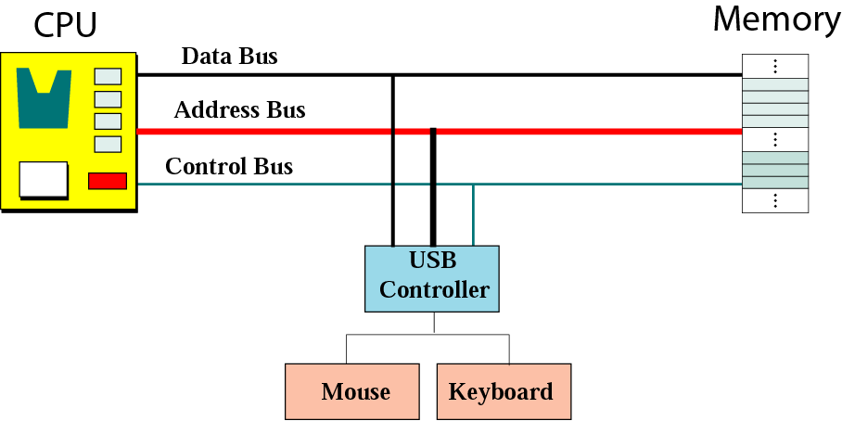
USB controller
00.Computer & Related\PPTs.2009\Part II Computer architecture.pptx

Slide 48
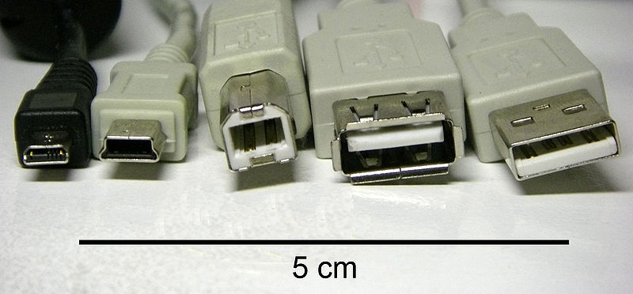
Different types of USB connectors (from left to right)
• 8-pin AGOX • Mini-B plug • Type B plug
• Type A receptacle • Type A plug
The data cables for USB 1.x and USB 2.x use a twisted pair to reduce noise and crosstalk.
00.Computer & Related\PPTs.2009\Part II Computer architecture.pptx
48

Slide 49
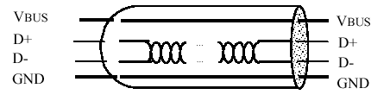
Physical Interface
pin | Name | Descryption
1 | Vcc | +5 Vdc
2 | D- | Data-
3 | D+ | Data+
4 | GND | Ground

Slide 50

USB communication takes the form of packets
Cutting the huge target into fixed size packets
Just as we do in Networking
Each packet has unique ID
Merge all the packets again to rebuild the huge target
After all packets are collected
How to move this huge Buddha to other place？
Just as the data is transferred through network!
00.Computer & Related\PPTs.2009\Part II Computer architecture.pptx
http://www.diybl.com/course/6_system/linux/Linuxjs/2007104/76113_15.html
Notes:
In electronics, the term crosstalk (XT) refers to any phenomenon by which a signal transmitted on one circuit or channel of a transmission system creates an undesired effect in another circuit or channel.
------- http://en.wikipedia.org/wiki/Crosstalk_%28electronics%29

Slide 51
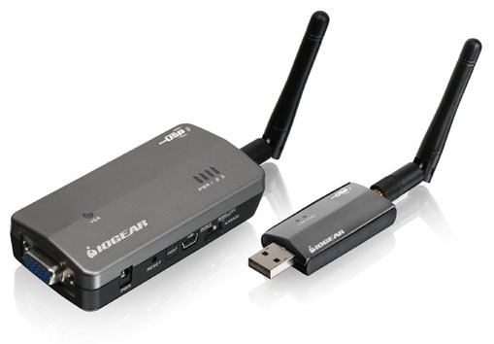
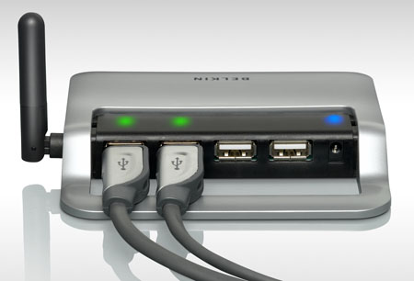
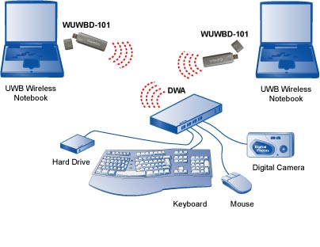
USB Applications now
Wireless video display
Home and office
MP3s
General data transfer
And More
Part XII USB-mkezele-eseary-20090401.ppt

Slide 52
Advanced IO
Scheduling algorithms for disk I/O requests
SPOOLING
RAID
Redundant backup for the safe storage
USB
Universal interface for diverse devices
NAS, SAN, ...
Scattered storage
Simultaneous Peripheral Operations On-line:
同时的外围设备联机操作(假脱机技术)

Slide 53
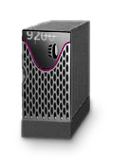
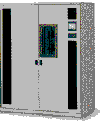
DAS: Direct Attached Storage
We are familiar with this.
Clients
LAN
Application
Servers
Win2k
Linux
Unix
Win2k
Linux
Unix
SCSI
FC
FC
Tape
Direct Attached Storage

Slide 54
NAS: Network Attached Storage [网络附加存储]
Each Device Connected Directly to network, with own IP Address
Various Devices (CD towers, Tape Towers, SCSI Towers, Specialty Servers)
If a Server crashes, the data on a NAS device may be still accessible, depending on what device is used
LAN
Win2k
Linux
Unix
Generic
Generic
Application
Servers
NAS Appliances
or
NAS Head Ends

Slide 55
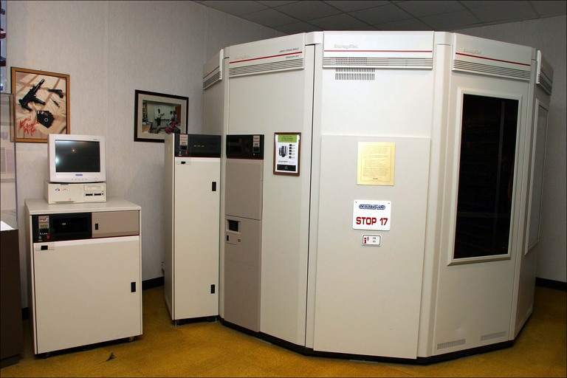
StorageTek Automated Cartridge System (ACS), with 6,000 tape cartridges storing a total of 300 terabytes
Location: Laurel, Maryland Date: June 2004
Camera: Canon EOS 10D ID Number: #88015409
http://www.mccullagh.org/image/10d-15/storagetek-automated-cartridge-system.html

Slide 56
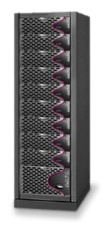
SAN: Storage Area Network [存储(区)域网(络)]
Storage is accessed at block level not at file level
Very high performances
Storage is shared
Good management tools
Interoperability issues
Clients
LAN
Database Servers
Fibre Channel SAN
Block Storage Devices
Storage Area Network (SAN)

Slide 57
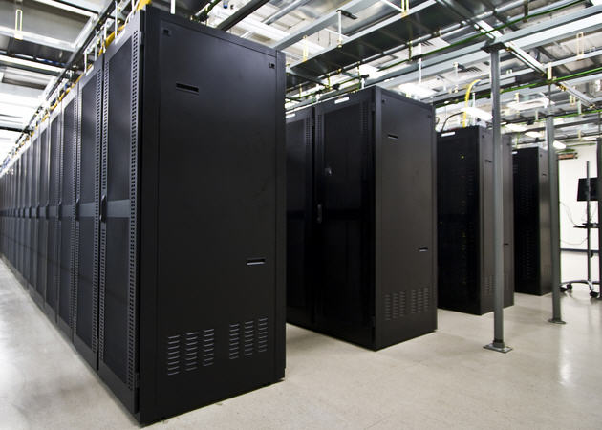
One is not adequate of course
Google datacenter
http://www.muycomputer.com/2011/08/02/google-tiene-900-000-servidores-en-todo-el-mundo

Slide 58
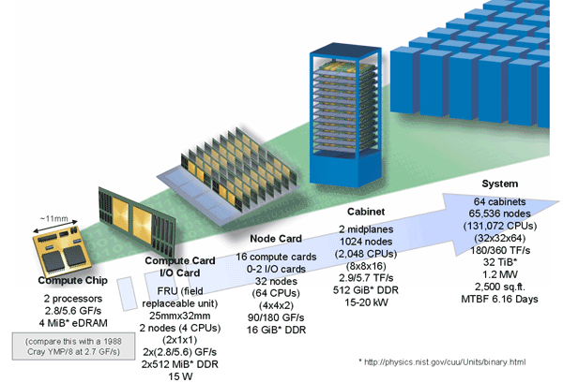
Non-von Neumann Architectures are also popular
Since 1990, alternative parallel-processing systems have entered the marketplace.
They have the potential to process much more data at much higher speeds.
Blue Gene/L

Slide 59
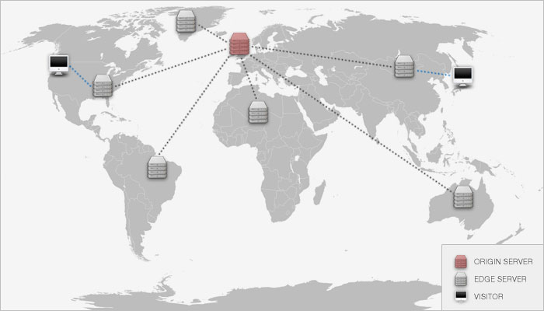
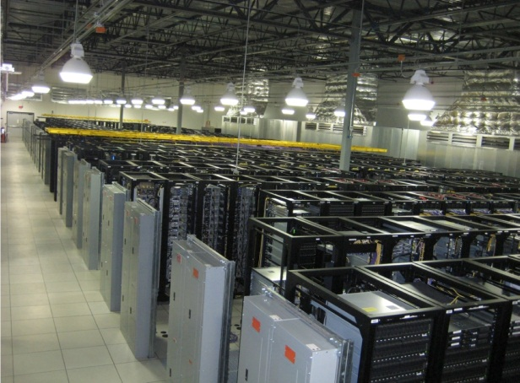
Distributed System!
Many nodes

